Slide 1
I❤R
Kin Wong (Sam)
kiwong@jjay.cuny.edu

Slide 2
Game Plan
Intro R
Import SPSS file
Descriptive Statistics
Inferential Statistics
Graphs
Q&A

Slide 3
Intro R

Slide 4
R
Small, Fast, and Open Source (Window, Linux, and Mac)
Write your own package or improve existing packages.
Free packages For Downloads (5000+)
  From Forensic to Finance, there is a package right for you.
Disadvantage: Command Driven & Debugging

Slide 5
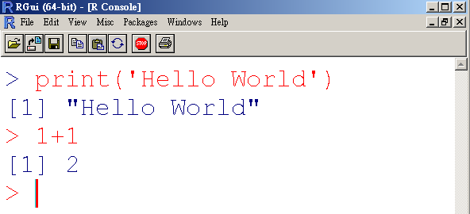
R

Slide 6
Exercise
print()
  Use print() to print your name
? is your best friend, use ? for help
  ?print
Calculate
  Calculate 888*888

Slide 7
Enter data
c()
  Use c() to enter data into R
Try
  Store 1,2,3,4, and 5 into data variable
  data =c(1,2,3,4,5)
Type data to call your number
  data

Slide 8
Import CSV in R
Store your file address in dataset variable.
  dataset ="D:/accidents.csv“
Warning: R uses “/” instead of “\”
Load csv file into data variable:
  data=read.table(dataset, header=T, sep=",")

Slide 9
Import SAV in R
SAV = SPSS File

Slide 10
tcltk (Select a File with GUI)
library() loads tcltk package into memory
  library(tcltk)
R opens a select file window
  dataset <- tclvalue(tkgetOpenFile(filetypes="{{All files} *}"))
Check dataset file location:
  dataset

Slide 11
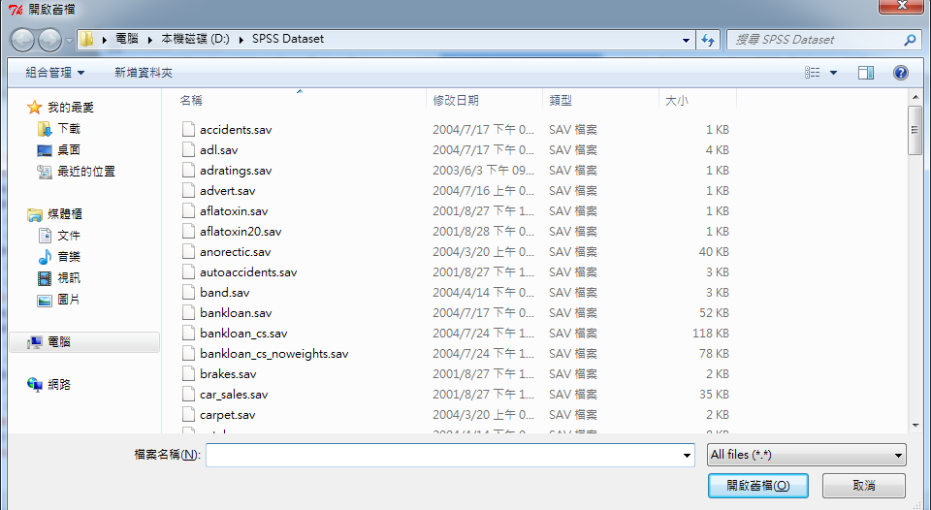
tcltk (Successful)

Slide 12
Import SAV in R
Install foreign package to import SPSS file
  install.packages(c("foreign"), repos="http://cran.r-project.org" )
Load foreign package import SPSS file.
    library(foreign)
No error message = Command is correct.

Slide 13
Import SAV in R
Copy & Paste:
  data=read.spss(dataset, use.value.labels=TRUE,max.value.labels=Inf, to.data.frame=TRUE)
Use read.spss() function to import SPSS file.
dataset is your SPSS file location.
to.data.frame=TRUE means import as spreadsheet.

Slide 14
Attach data
attach() function mounts your data.
If you do not mount the data, you need to identify your variables with data$.
Try:
  attach(data)

Slide 15
Show all Variables
ls() function lists all variables names
Try:
  ls(data)

Slide 16
R Code (Load SPSS file)
library(tcltk)
dataset <- tclvalue(tkgetOpenFile(filetypes="{{All files} *}"))
library(foreign)
data=read.spss(dataset, use.value.labels=TRUE,max.value.labels=Inf, to.data.frame=TRUE)
attach(data)
ls(data)

Slide 17
Descriptive Statistics
Replace ☺ w/ Your Variable

Slide 18
Frequency table
Frequency table
  table(☺)
Total Frequency
  length(☺)
Missing
  length(which(is.na(☺)))
Valid
  length(☺)-length(which(is.na(☺)))

Slide 19
Percentile
Quartiles
  quantile(☺)
Percentile
  quantile(☺, c(0,.50,1))
c() allows you to input as many percentile as you wanted. From 0 to 1.

Slide 20
Central Tendency
Mean
  mean(☺)
Median
  median(☺)
Mode
  names(sort(-table(☺))
Sum
  sum(☺)

Slide 21
Dispersion
Range = Max - Min
  range(☺)[2]-range(☺)[1]
Variance
  var(☺)
Standard deviation
  sd(☺)
Standard error
  sd(☺)/sqrt(length(☺)-length(which(is.na(☺))))

Slide 22
Distribution
Install e1071 package to import SPSS file
  install.packages(c("e1071"), repos="http://cran.r-project.org" )
Load e1071 package in order to use skewness and kurtosis function.
  library(e1071)

Slide 23
Distribution
Skewness
  skewness(☺)
Kurtosis
  kurtosis(☺)

Slide 24
Compare Mean
☺ is the dependent variable
☹ is the independent variable
Copy & Paste: (Compare Mean)
  tapply(☺, ☹,mean)
Note: You can change mean to other R functions.
Copy & Paste: (Compare Range)
  tapply(☺, ☹,range)

Slide 25
Inferential Statistics

Slide 26
One sample t-test
One sample t-test
  t.test(☺,mu=0)
mu = 0 means that population mean = 0.
You can change 0 to you desired population mean.

Slide 27
Pair sample t-test
Pair sample t-test
  t.test(☺,☹,paired=T)
☺ is the first variable
☹ is the second variable
paired=T means that this is a pair sample t-test.

Slide 28
Independent sample t-test
Install car package to run Levene’s test
  install.packages(c(“car"), repos="http://cran.r-project.org" )
Load car package
  library(car)

Slide 29
Independent sample t-test
☺ is dependent variable
☹ is independent variable
Levene’s test
  leveneTest(☺, ☹,'mean')
‘mean’ uses original Levene’s test

Slide 30
Independent sample t-test
Set values for independent sample t-test
  Test1= ☹ =='boy‘
  Test2= ☹ ==‘girl'
Test1 holds independent variable’s boy value You can change
Test2 holds independent variable’s girl value boy/girl to your
value.

Slide 31
Independent sample t-test
Set Groups
  Group1=dataset[Test1,]$ ☺
  Group2=dataset[Test2,]$ ☺
Runs equal variance assumed independent sample t-test
  t.test(Group1,Group2,var.equal=T)
Runs equal variance not assumed independent sample t-test
  t.test(Group1,Group2,var.equal=F)

Slide 32
ANOVA
☺ is dependent variable
☹ is independent variable
Levene’s Test
  leveneTest(☺, ☹ ,'mean')
Anova Table (Equal-variance Assumed)
  summary(aov(☺ ~ ☹))

Slide 33
ANOVA
One-way table (Equal-variance not assumed)
  oneway.test(☺ ~ ☹)
Post-hoc test – Tukey
  posthoc(☺, ☹,'Tukey')
Post-hoc test – Tukey
  posthoc(☺, ☹,'Games-Howell')

Slide 34
Correlation
Install Hmisc package to generate correlation table
  install.packages(c(“Hmisc"), repos="http://cran.r-project.org" )
Load foreign package
  library(Hmisc)

Slide 35
Correlation
☺ is variable y.
☹ is variable x.
Correlation table
  rcorr(☹, ☺,type='pearson')

Slide 36
Linear Regression
☺ is dependent variable
☹ is independent variable
Linear Regression:
  summary(lm(☺ ~ ☹))

Slide 37
Crosstab
Install gmodels package to generate crosstab table
  install.packages(c(“gmodels"), repos="http://cran.r-project.org" )
Load gmodels package
  library(gmodels)

Slide 38
Crosstab
☺ is row variable
☹ is column variable
Crosstab table
  CrossTable(☺, ☹,expected=TRUE,prop.chisq=TRUE)

Slide 39
R Graphs

Slide 40
Game Plan
R Graphs
1)Bar Chart | 3)Boxplot
2)Histogram | 4)Scatter plot
ggplot2

Slide 41
R Graphs
without ggplot2

Slide 42
Bar Chart
Simple Bar Plot
Simple Horizontal Bar Plot
Staked Bar Plot
Grouped Bar Plot

Slide 43
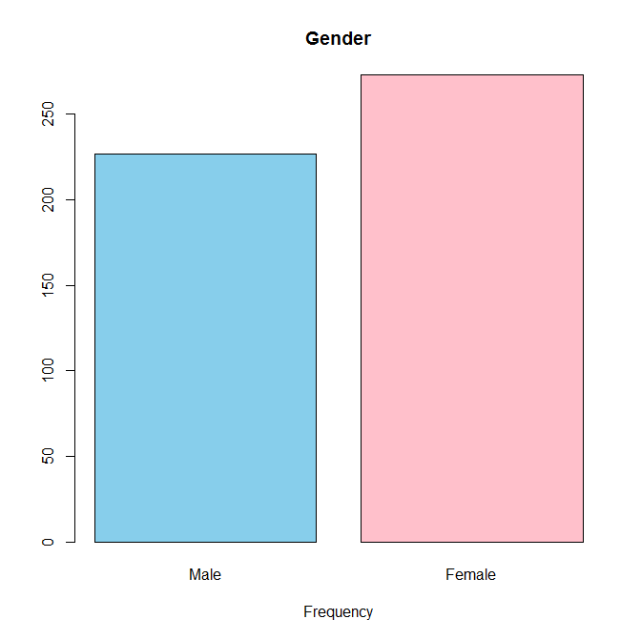
Bar Chart - Simple Bar Plot

Slide 44
Bar Chart - Simple Bar Plot
Copy & Paste
  counts <- table(gender)
  barplot(counts, main=" Gender",xlab="Frequency",col=c("skyblue","pink"))
barplot() requires input variable to sum up(table()) before calculation.
main() is the header
xlab() is the footer
col() allows you to define color for value 1, value 2, and etc…

Slide 45
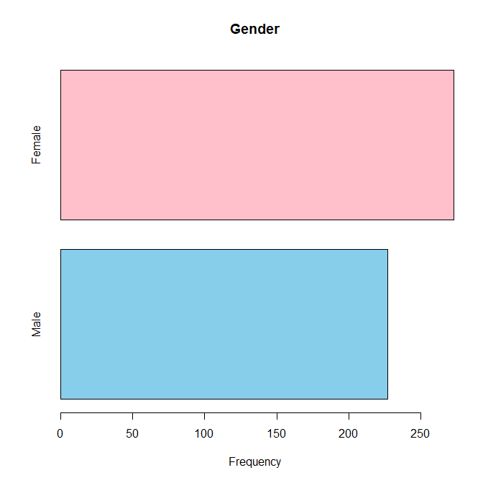
Bar Chart - Simple Horizontal Bar Plot

Slide 46
Bar Chart - Simple Horizontal Bar Plot
Copy & Paste
  counts <- table(gender)
  barplot(counts, main=" Gender",xlab="Frequency",col=c("skyblue","pink"), horiz=TRUE)
When you add horiz=TRUE, your bar chart will rotate.

Slide 47
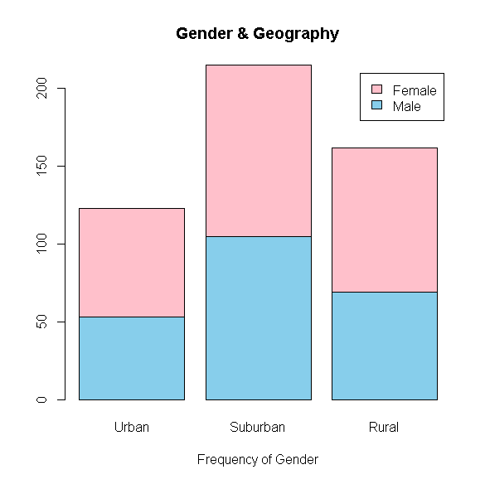
Bar Chart - Staked Bar Plot

Slide 48
Bar Chart - Staked Bar Plot
Copy & Paste
  counts <- table(gender,urban)
  barplot(counts, main="Gender & Geography",
  xlab="Frequency of Gender", col=c("skyblue","pink"),
  legend = rownames(counts))

Slide 49
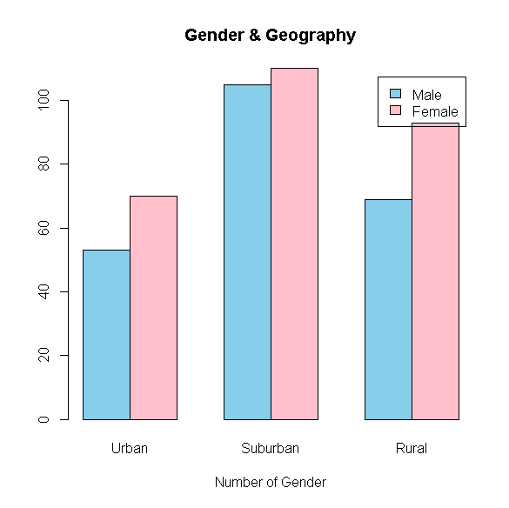
Bar Chart - Grouped Bar Plot

Slide 50
Bar Chart - Grouped Bar Plot
Copy & Paste
  counts <- table(gender, urban)
  barplot(counts, main="Gender & Geography",
  xlab="Number of Gender", col=c("skyblue","pink"),
  legend = rownames(counts), beside=TRUE)

Slide 51
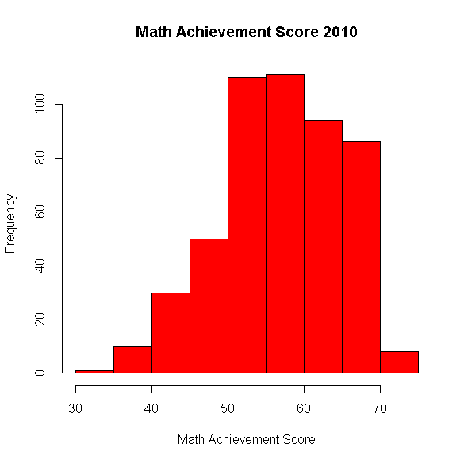
Histogram

Slide 52
Histogram
Copy & Paste
  hist(achmat10, col="red", xlab="Math Achievement Score" , main="Math Achievement Score 2010“, breaks=9)
breaks() tells R to produce X amount of bar(s)

Slide 53
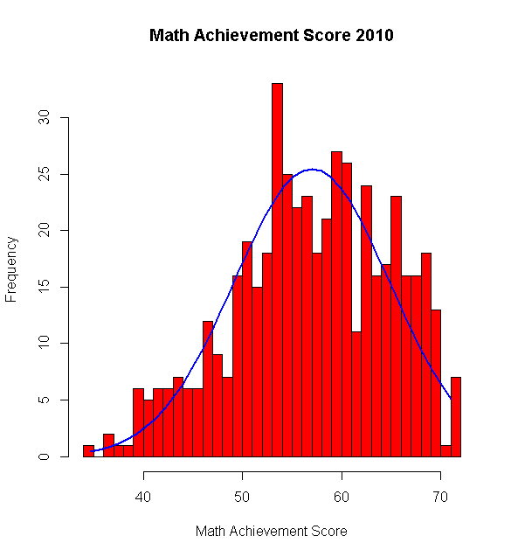
Histogram w/ Normal Curve

Slide 54
Histogram w/ Normal Curve
Copy & Paste
  x <- achmat10
  h<-hist(x, breaks=50, col="red", xlab="Math Achievement Score",
  main="Math Achievement Score 2010")
  xfit<-seq(min(x),max(x),length=40)
  yfit<-dnorm(xfit,mean=mean(x),sd=sd(x))
  yfit <- yfit*diff(h$mids[1:2])*length(x)
  lines(xfit, yfit, col="blue", lwd=2)

Slide 55
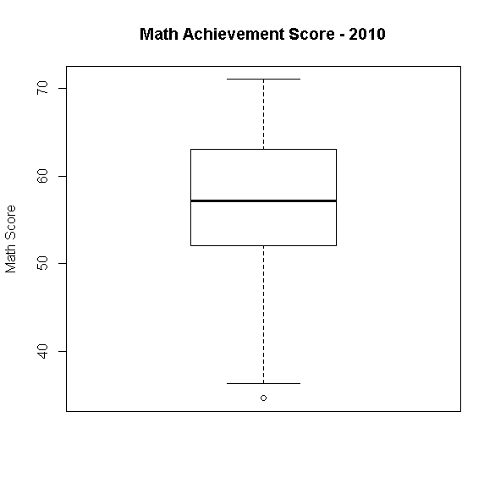
Boxplot

Slide 56
Boxplot
Copy & Paste
  boxplot(achmat10,main="Math Achievement Score - 2010",ylab="Math Score")

Slide 57
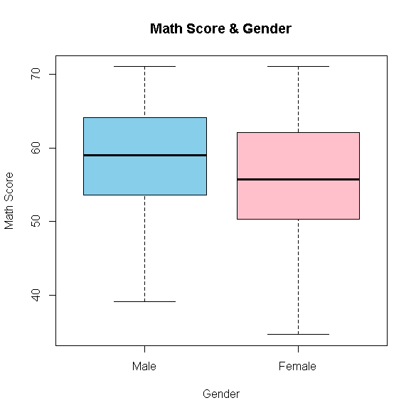
Multi-Boxplot

Slide 58
Boxplot
Copy & Paste
  boxplot(achmat10~gender, main="Math Score & Gender",ylab="Math Score", xlab="Gender", col=(c("skyblue","pink")))
achmat10 is dependent variable
gender is independent variable

Slide 59
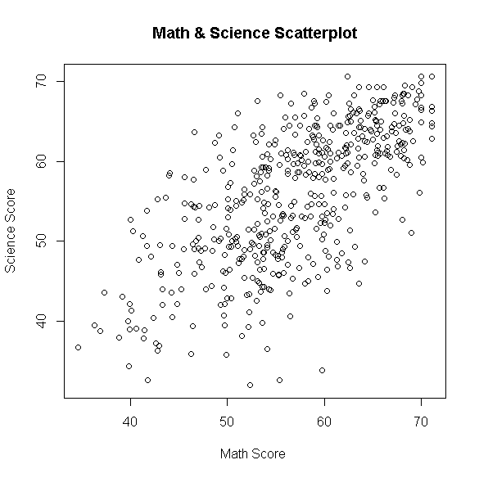
Scatter plot

Slide 60
Scatter plot
Copy and Paste
  plot(achmat10,achsci12,main="Math & Science Scatterplot",xlab="Math Score ", ylab="Science Score", pch=1)

Slide 61
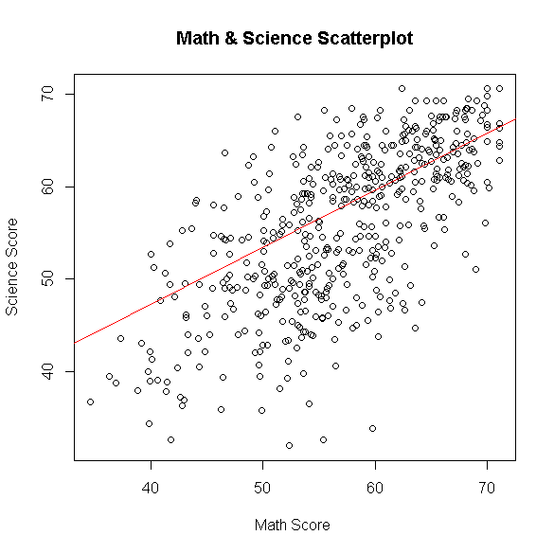
Scatter plot w/ Regression line

Slide 62
Scatter plot w/ Regression line
Copy and Paste
  abline(lm(achmat10~achsci12), col="red")
Add regression line to plot

Slide 63
ggplot2
Quick & High Quality Graphs

Slide 64
ggplot2
qplot()
  Quick high-quality graph development
  Little room for improvement
ggplot()
  Slow graph development (lines of code)
  Very Elegant

Slide 65
Import ggplot2 in R
Install ggplot2 package
  install.packages(c(“ggplot2"), repos="http://cran.r-project.org" )
Load ggplot2 package into memory.
  library(ggplot2)

Slide 66
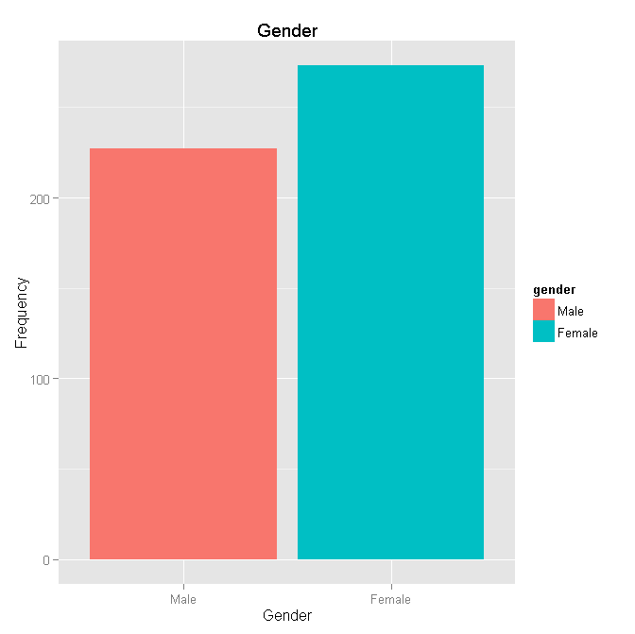
Bar Chart

Slide 67
Bar Chart
Copy and Paste
  qplot(factor(gender),geom="bar", fill=gender,xlab="Gender",ylab="Frequency",main="Gender")

Slide 68
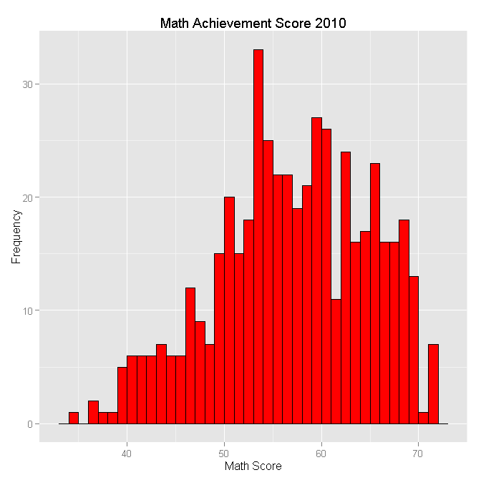
Histogram

Slide 69
Histogram
Copy and Paste
  a=qplot(achmat10,xlab="Math Score",ylab="Frequency",main="Math Achievement Score 2010", binwidth = 1)
  a+geom_histogram(colour = "black", fill = "red", binwidth = 1)

Slide 70
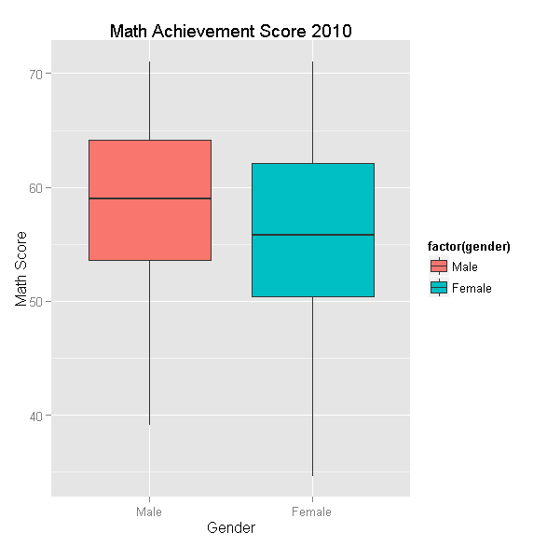
Boxplot

Slide 71
Boxplot
Copy and Paste
  a=qplot(factor(gender),achmat10, geom = "boxplot",ylab="Math Score",xlab="Gender",main="Math Achievement Score 2010")
  a + geom_boxplot(aes(fill = factor(gender)))

Slide 72
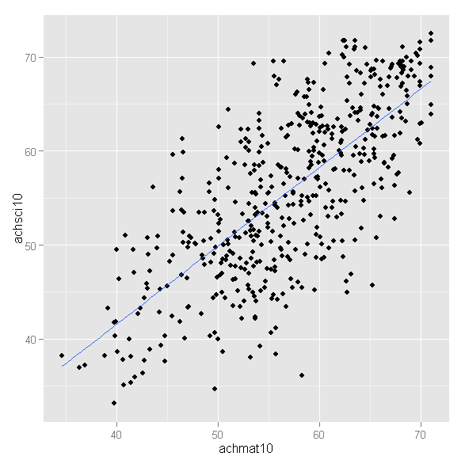
Scatter plot

Slide 73
Scatter plot
Copy and Paste
  a=qplot(achmat10,achsci10)
  a+geom_smooth(method=lm,se=FALSE)

Slide 74
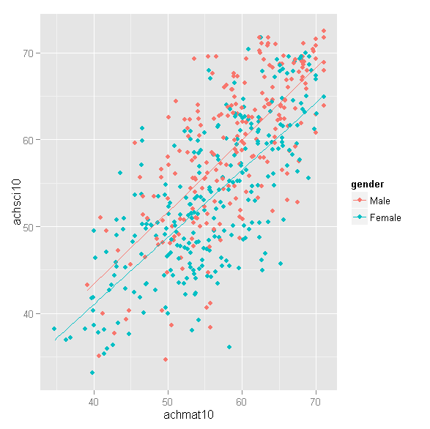
Scatter plot

Slide 75
Scatter plot
Copy and Paste
  a=qplot(achmat10,achsci10,color=gender)
  a+geom_smooth(method=lm,se=FALSE)

Slide 76
Source
R Graphs
  statmethods.net
  http://www.statmethods.net/graphs/
ggplot2
  Cookbook for R
  http://www.cookbook-r.com/Graphs/

Slide 77
Question & Answer
Kin Wong (Sam)
kiwong@jjay.cuny.edu

